Slide 1
Deadlock

Slide 2
Introduction
In a multiprogramming environment, several processes may compete for a finite number of resources. A process requests resources ; if the resources are not available at that time, the process enters a waiting state . Sometimes, a waiting process is never again able to change state, because the resources it has requested are held by other waiting processes. This situation is called a deadlock .

Slide 3
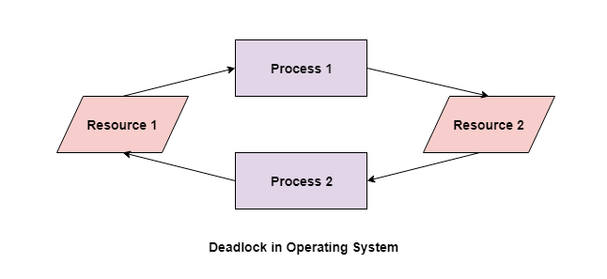

Slide 4
In the above diagram, the process 1 has resource 1 and needs to acquire resource 2. Similarly process 2 has resource 2 and needs to acquire resource 1. Process 1 and process 2 are in deadlock as each of them needs the other’s resource to complete their execution but neither of them is willing to relinquish their resources.
A deadlock will only occur if the four Coffman conditions hold true.

Slide 5
Mutual Exclusion
Mutual exclusion implies there should be a resource that can only be held by
one process at a time. This means that the resources should be non-sharable.
Hold and Wait
A process can hold multiple resources and still request more resources from
other processes which are holding them.
No preemption
A resource cannot be preempted from a process by force. A process can only release a
resource voluntarily.
Circular wait
A process is waiting for the resource held by the second process, which is waiting for
the resource held by the third process and so on, till the last process is waiting for a
resource held by the first process. This forms a circular chain.

Slide 6
Methods for Handling Deadlocks
1. Deadlock Ignorance
Deadlock ignorance is the most widely used approach among all the mechanism.
This is being used by many operating systems mainly for end user uses.
In this approach, the Operating system assumes that deadlock never occurs. It simply
ignores deadlock. This approach is best suitable for a single end user system where
User uses the system only for browsing and all other normal stuff.
2. Deadlock prevention
Deadlock happens only when Mutual Exclusion, hold and wait, No preemption and
circular wait holds simultaneously. If it is possible to violate one of the four conditions
at any time then the deadlock can never occur in the system.
deadlock.

Slide 7
3. Deadlock avoidance
In deadlock avoidance, the operating system checks whether the system is in safe state or in unsafe state at every step which the operating system performs. The Process continues until the system is in safe state. Once the system moves to unsafe state, the OS has to backtrack one step.
4. Deadlock detection and recovery
This approach let the processes fall in deadlock and then periodically check whether deadlock occur in the system or not. If it occurs then it applies some of the recovery methods to the system to get rid of of deadlock.

